Slide 1
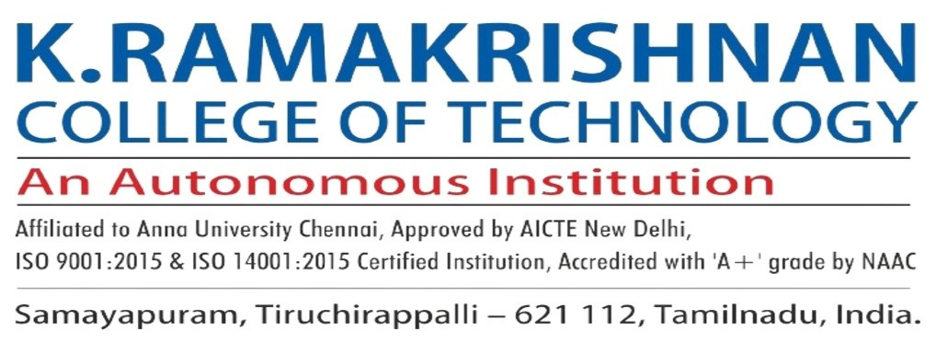

Online Vehicle Parking Reservation System
Batch No: 17
Done By
Arul Prakash.M - 811721243008
Sri Balaji.S - 811721243053
Manoj Prabakar.B - 811721243302
Project Guide:
Mrs. A.Sumathi M.E (AP/AI)

Slide 2
Objective:
The primary objective of the Online Vehicle Parking Reservation System is to provide a seamless, efficient, and user-friendly platform for reserving parking spaces in urban areas, reducing the complexities associated with finding and securing parking in crowded environments. As cities expand and the number of vehicles increases, parking has become a significant issue, leading to congestion, time wastage, and frustration for vehicle owners. This system aims to alleviate these issues by allowing users to book parking spots in advance, ensuring parking is available when needed.

Slide 3
Existing system:
User Interface: Users can access the system through a web or mobile application to check parking availability, make reservations, and manage bookings.
Parking Sensors: IoT sensors installed in parking spaces detect the presence of vehicles and transmit real-time occupancy data to the system.
Data Processing and Analysis: The system processes incoming sensor data to determine parking availability, predict future occupancy, and optimize space utilization.
Reservation Management: Users can select desired parking locations, dates, and times for their reservations. The system confirms bookings, updates availability status, and sends notifications to users.

Slide 4
Proposed system:
1. IoT-Enabled Smart Parking System:
IoT-based sensors detect available parking spots and update the system in real-time.
Wireless communication between parking spaces and a central server ensures accurate availability updates.
Automated parking spot allocation reduces human intervention.
2. AI-Powered Parking Space Prediction:
AI algorithms analyze historical data and real-time inputs to predict parking space availability.
Machine learning models suggest the best parking spots based on user preferences.
AI-driven dynamic pricing optimizes space utilization during peak hours.

Slide 5
Proposed system:
3. Cloud-Based Centralized Data Management:
Cloud computing allows real-time data synchronization for parking space availability.
Centralized storage ensures scalability and security for user data, reservations, and transactions.
Parking facility owners can access analytics and reports for better management.
4. User-Friendly Mobile and Web Application:
Users can book, cancel, and modify reservations via a mobile app or website.
Notifications and alerts keep users informed about their bookings and available spots.
Reviews and feedback mechanisms allow users to rate parking spaces.

Slide 6
Literature Survey:
S.No | Paper Title | Author Name | Published year | Techniques used | Merits | Demerits
1. | Blockchain-Enabled Smart Parking System for Secure and Transparent Reservations. | Lee, H., & Kim, T. | 2023 | IoT sensor for parking space detection. Blockchain for secure transaction and reservation records. | Blockchain ensures secure and tamper-proof reservation records. | Blockchain integration increases system complexity and computational overhead.
2. | Implementation of an online parking reservation system using IoT-based sensors. | Gupta, R., & Sharma, S. | 2023 | IoT-based sensors for real-time parking space detection. Cloud computing for centralized data storage and accessibility. | The system provides a reliable and scalable solution. | The success of the system is highly dependent on the stability.

Slide 7
Literature Survey:
S.No | Paper Title | Author Name | Published year | Techniques used | Merits | Demerits
3. | Smart Parking System Using IoT and Machine Learning for Efficient Parking Management. | Kumar, A., & Singh, P. | 2022 | IoT sensors for real-time parking slot monitoring. Machine Learning algorithms for predicting parking availability. | The system reduces parking search time and optimizes space utilization. | High dependency on network connectivity for real-time updates.
4. | Optimizing Parking Space Utilization through IoT-enabled Reservation Systems: A Review | Patel, M., & Gupta, P. | 2022 | Blockchain technology for secure and tamper-proof transactions. Smart contracts for automated reservation and payment processing. | Ensures security and transparency. Reduces dependency on third-party payment processor | High computational costs and slower transaction speeds during peak hours.

Slide 8
Literature Survey:
S.No | Paper Title | Author Name | Published year | Techniques used | Merits | Demerits
5. | Smart parking system utilizing RFID (Radio Frequency Identification) technology for both vehicle identification and parking spot management. | Patel, N., & Desai, A. | 2021 | RFID technology for vehicle identification and authentication. Automated entry and exit tracking using RFID sensors. | It Ensures accurate vehicle identification Automated parking access. | Limited flexibility if RFID tags are lost or damaged.

Slide 9
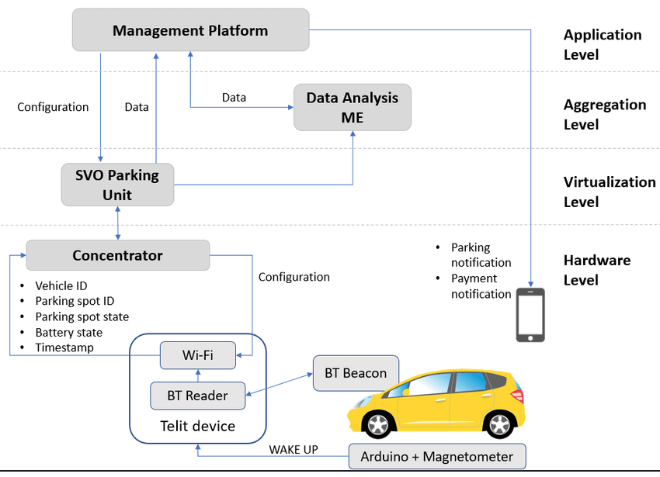
Architecture:

Slide 10
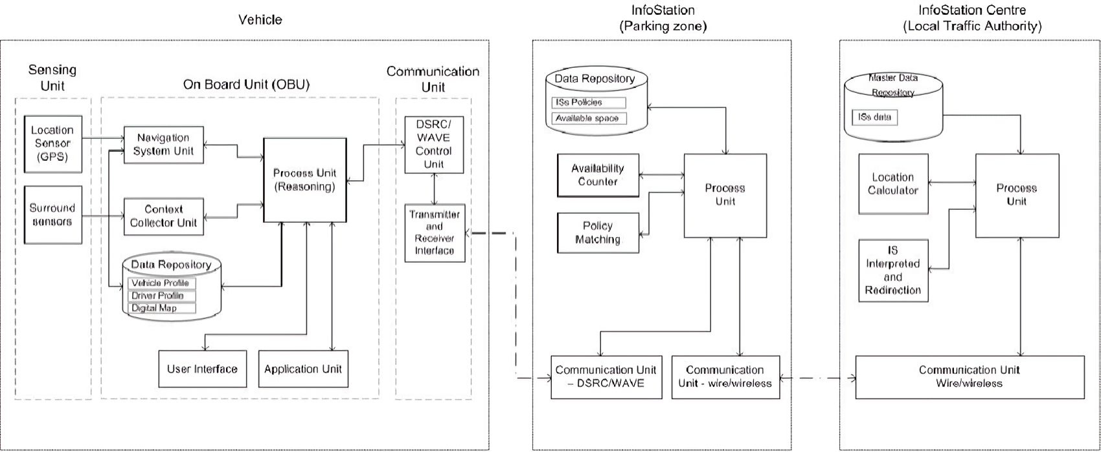
Architecture:

Slide 11
System Specification:
SOFTWARE REQUIREMENTS:
OS: Windows 10/11 (64-bit), macOS 10.14 (Mojave) or later, Linux with GNU C Library (glibc) 2.31 or later
IDLE: JAVA web
Software: Compatible web browsers (e.g., Chrome, Firefox, Safari)
Additional: Internet connectivity, GPS module for location services, IoT device compatibility for sensor integration
HARDWARE REQUIREMENTS:
RAM: Minimum 4 GB RAM, recommended 8 GB RAM
Processor: Dual core Processor
Disk Space: Minimum 5 GB, recommended 10 GB (excluding system and project files)
Screen Resolution: Minimum 1366 x 768

Slide 12
Modules:
User Management
Parking Slot Management
Payment Processing
Spot Switching
Vehicle Access Control and Security

Slide 13
Module 1: User Management :
Purpose: Manages user accounts, profiles, and access permissions.
The user management module is the backbone of the parking system, responsible for handling user accounts, profiles, and access permissions.
It allows users to register and authenticate themselves securely through a login/logout mechanism. The module also supports role-based access control, ensuring that different user roles (Admin, User, and Guest) have appropriate permissions.
For instance, Admins can manage all user accounts and system settings, while Users can update their personal details and vehicle information.
Admins, on the other hand, can monitor user activity and manage permissions effectively. Use cases include new users registering for the system, existing users updating their profiles, and admins managing user roles and permissions.

Slide 14
Module 1: User Management :
Benefits:
Ensures secure access to the parking system.
Personalizes user experience based on roles and preferences.
Use Cases:
Admins can manage all users and permissions.
Users can update their vehicle details for better parking suggestions.

Slide 15
Module 2: Parking Slot Management :
Purpose: Manages the allocation and availability of parking slots.
Parking Slot Management is designed to manage the allocation and availability of parking slots in real-time. It integrates with sensors and IoT devices to detect occupancy and update slot availability dynamically.
Users can reserve slots in advance, and the system ensures that reserved slots are not allocated to others. It also supports features like slot release, where users can free up their slots if they no longer need them.
Use cases include users reserving slots before arriving at the parking facility, sensors detecting occupancy and updating the system in real-time, and Admins monitoring slot usage to identify trends and make improvements.
It reduces the time users spend searching for parking by providing real-time slot availability information. It also optimizes space utilization, ensuring that no slots are left unused unnecessarily.

Slide 16
Module 2: Parking Slot Management :
AI algorithm:
Computer vision and YOLO techniques are used in this parking slot management to capture real-time images of parking spaces by the cameras.
It detects vehicle presence and classifies empty/filled slots.
It distinguishes between cars, trucks, and electric vehicles by using YOLO provides real-time object detection with high accuracy.
The parking system labels each parking spot as “occupied” or “vacant” and updates a central database.

Slide 17
Module 3: Payment Processing :
Purpose: Handles secure and seamless payment transactions.
The Payment Processing module handles all financial transactions within the parking system, ensuring secure and seamless payments.
It supports multiple payment options, including credit/debit cards, digital wallets, and other online payment methods.
The automated billing is based on parking duration, ensuring users are charged accurately. It also generates receipts and maintains a payment history for each user, providing transparency and accountability.
It enhances user convenience by offering flexible payment options and automating the billing process. It also ensures secure transactions, protecting user data and building trust.
Use cases include users paying for parking via their preferred method, the system generating receipts automatically, and Admins tracking revenue and payment trends for better financial management.

Slide 18
Module 3: Payment Processing :
Benefits:
Enhances user convenience with flexible payment options.
Ensures secure and transparent transactions.
Use Cases:
Users can pay for parking via their preferred method.
Admins can track revenue and payment trends.

Slide 19
Module 4: Spot Switching
Purpose: Allows users to switch parking spots if needed.
The Spot Switching module allows users to switch their parking spots if needed, providing flexibility and convenience.
It integrates with real-time slot availability data, enabling users to find and reserve alternative spots seamlessly.
The module updates reservations and notifies users about the changes, ensuring a smooth transition. This feature is particularly useful in dynamic environments where users may need to change their parking location.
The Spot Switching module provides users with flexibility and optimizes parking space utilization. Use cases include users switching to a more convenient spot, the system updating reservations automatically, and Admins managing spot allocation dynamically. This enhances user convenience and ensures efficient space management.

Slide 20
Module 4: Spot Switching :
AI algorithm:
RL for optimal spot reallocation is used by the Q-learning and Deep Q-Networks(DQN). The System treats each parking spot as a “state” and spot switching as an “action”.
The function used in RL by reduce walking distance for the user(+ reward) and better space utilization(+ reward). The user preference match for the spots are EV spots to the EV cars(+ reward) and the user requests to change the spot(eg., “Find me a closer spot”)
Real-time example:
A spot near the mall entrance opens up, the system automatically offers it to a user who originally booked a distant spot.

Slide 21
Module 5: Vehicle Access Control and Security
Purpose: Ensures secure and authorized vehicle access.
The Vehicle Access Control and Security module ensures that only authorized vehicles can access the parking facility.
It uses advanced technologies like license plate recognition and integrates with security cameras and alarms to monitor and control access.
The module prevents unauthorized entry, enhancing the overall security of the parking system. It also streamlines the entry and exit processes, reducing wait times for users.
This module enhances security and prevents unauthorized access. Use cases include registered vehicles gaining access automatically, security cameras monitoring the facility, and Admins controlling access in real time.

Slide 22
Module 5: Vehicle Access Control and Security
AI algorithm:
Isolation forest 2. LSTM encoders
1. Isolation forest:
It learns the algorithm that excels at detecting rare events/ outliers by the anomalies instead of profiling normal data points. The data inputs are analyzed in the parking systems are:
Entry/exit timestamps
Vehicle dwell times
Frequency of parking sessions

Slide 23
Module 5: Vehicle Access Control and Security
Fraud Detection: Identifies vehicles using cloned/stolen permits.
Security Threats: Flags suspicious loitering (vehicles staying 3x longer than average).
System Abuse: Detects bots mass-booking premium spots.
2. LSTM encoders:
LSTM (Long Short-Term Memory) Autoencoders learn compressed representations of normal parking behavior and flag deviations.
Parking-specific features analyzed the movement patterns through parking zones, typical arrival/departure sequences, and payment timing consistency.
Behavioral Profiling learns the normal patterns for each user (e.g., Employee always parks 8 AM – 5 PM) and flags deviations (same credential used at 2 AM).

Slide 24
Performance Chart Table:
AI Algorithm | Accuracy | Real-Time Capability | Scalability | Complexity | Resource Usage | Best Use Case
Computer Vision (CV) | Very High | High | High | High | High | Vehicle detection, parking spot identification via camera feeds
Isolation Forest | High | Moderate | Very High | Low | Low | Anomaly detection in parking patterns or fraudulent parking usage
LSTM Encoders | Very High | Moderate | High | Very High | Very high | Time-series prediction of parking demand and occupancy trends
Reinforcement Learning (RL) | Very High | High | Very High | High | Moderate to High | Dynamic space allocation, intelligent pricing, autonomous control of work flow

Slide 25
Advantages:
Reduces Time and Traffic Congestion
Enhances Security
Improves Revenue Management
Provides Seamless Payments
Increases User Convenience
Supports Smart City Initiatives

Slide 26
Applications:
Real-Time Parking Availability
Flexible Reservation Options
Dynamic Pricing and Payment Integration
Automated Alerts and Notifications
Data Analytics and Insights
Commercial Offices
Shopping Malls
Airports
Stadiums and Event Locations
Public Transport Hubs

Slide 27
Conclusion:
The online vehicle parking reservation system represents a significant leap forward in modernizing parking management, aligning with the demands of our increasingly digital world. This innovative system is a convenience and a necessity, empowering users clients, employees, and system administrators—to reserve parking spaces seamlessly online. To eliminate the time-consuming process of searching for available spots, by enhances efficiency and reduces frustration for drivers. Additionally, the system improves property safety through organized, numbered parking spaces, ensuring a secure and structured environment.

Slide 28
References:
Smart Parking Solutions Inc. (2023). Intelligent Parking Management Systems: Enhancing Urban Mobility. Available: https://www.smartparkingsolutions.com/intelligent-parking-systems. Last accessed 15th October 2023.
Park Ease Technologies. (2022). Revolutionizing Parking with AI-Driven Solutions. Available: https://www.parkease.tech/ai-parking-solutions. Last accessed 12th September 2023.
Urban Mobility Research Group. (2021). Optimizing Parking Spaces in Smart Cities: A Case Study. Available: https://www.urbanmobilityresearch.org/parking-optimization. Last accessed 5th August 2023.
Green Park Innovations. (2023). Eco-Friendly Parking Solutions: Reducing Carbon Footprints in Urban Areas. Available: https://www.greenparkinnovations.com/eco-parking. Last accessed 20th July 2023.
Tech Park Systems. (2022). The Future of Parking: Autonomous Vehicles and Smart Infrastructure. Available: https://www.techparksystems.com/future-of-parking. Last accessed 10th June 2023.

Slide 29
THANKYOU

